Slide 1
Measurements
Science Lesson
Physics

Slide 2

Goals & objectives
7TWSc.02 Decide what equipment is required to carry out an investigation or experiment and use it appropriately.
7TWSc.03 Evaluate whether measurements and observations have been repeated sufficiently to be reliable.
7TWSc.04 Take appropriately accurate and precise measurements, explaining why accuracy and precision are important.

Slide 3
Agenda
01
03
02
04
Warm up activity
International system of units
Assignment
Introduction to physics

Slide 4
Warm up activity
01
Choose the odd word out
1- chair – water – balloon – sound.
2- light – book – vapour – milk.
3- electricity – oil – oxygen – pen.
4- table – vinegar – heat – helium.

Slide 5
Choose the odd word out
1- chair – water – balloon – sound.
2- light – book – vapour – milk.
3- electricity – oil – oxygen – pen.
4- table – vinegar – heat – helium.
The circled words are different forms of energy but other
Words are from the states of matter either solids, liquids or gases.

Slide 6
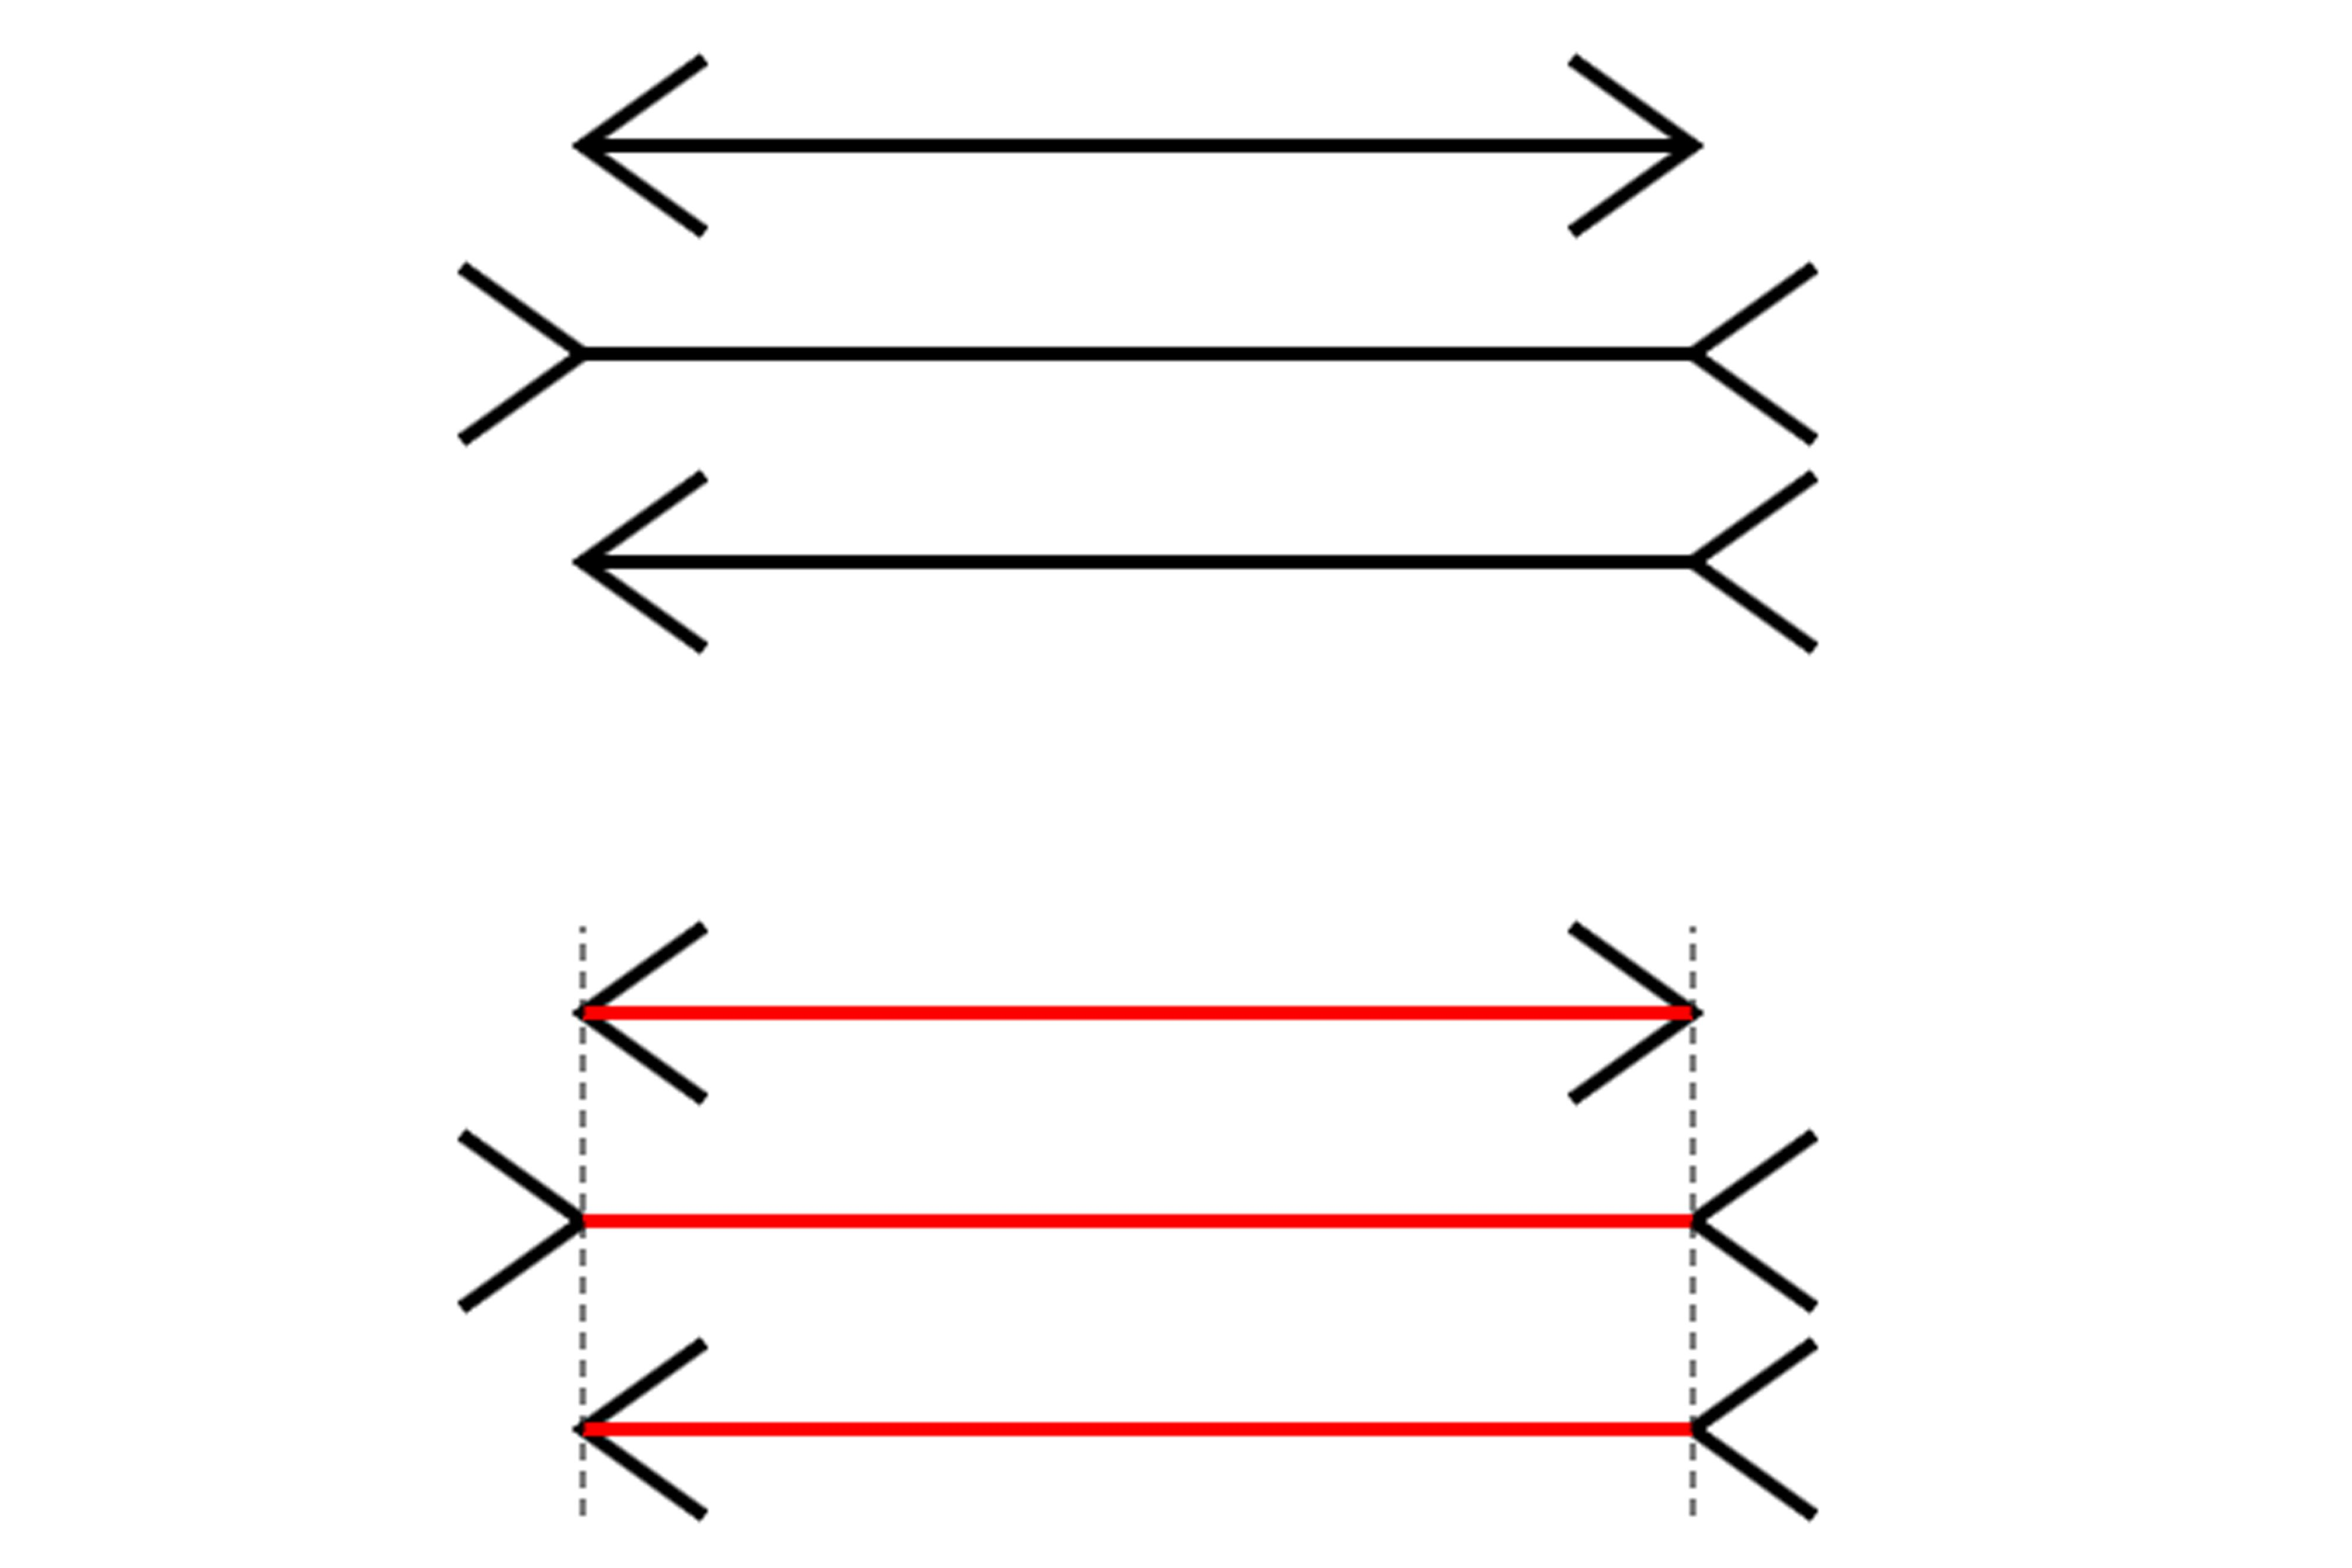
Optical illusion
All of our senses can be fooled into seeming to detect something that is not really present.
We need to take measurements to make more accurate observations.

Slide 7
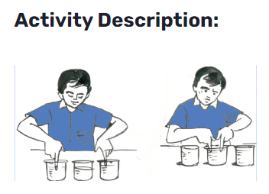
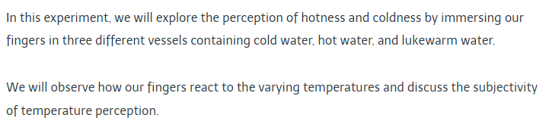
Activity

Slide 8
International system of units
03
Any measurement is made in units.
There is an international system of units that is used by scientists across the world.
Units in the international system is called (SI units).
All symbols for SI units have no full stop is placed after it.

Slide 9
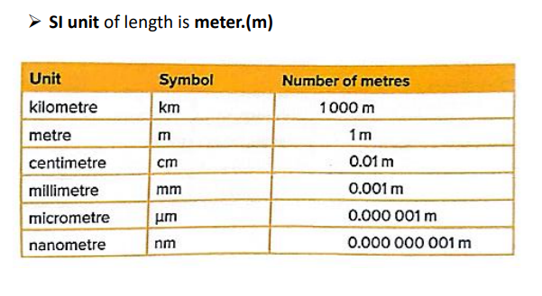
Measuring Length

Slide 10
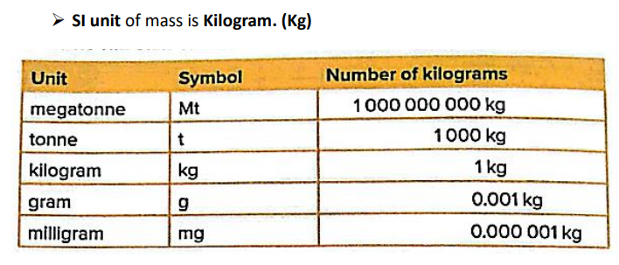
Measuring Mass

Slide 11
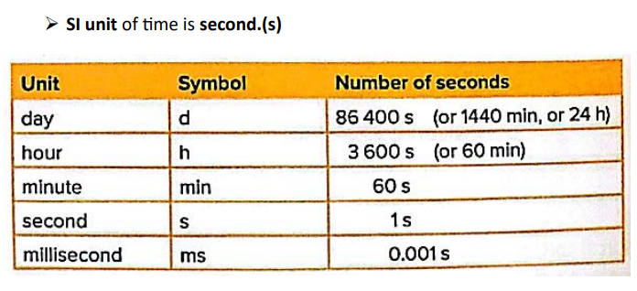
Measuring Time

Slide 12
Study well

Slide 13
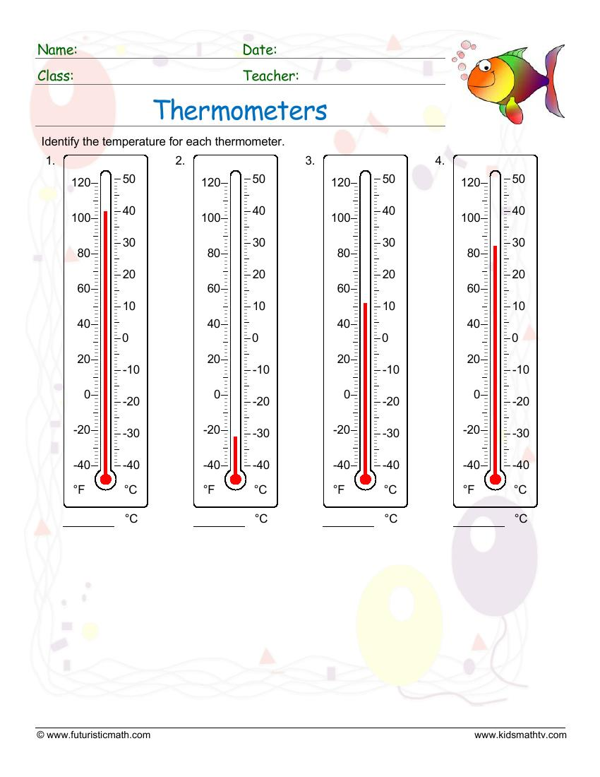
Assignment
04

Slide 14
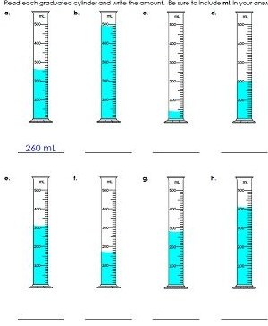
Assignment
04

Slide 15
Assignment
04
Thermometer is used in measuring ………………..
Graduated cylinder is used in measuring……………
………………………….. is used in measuring length.
………………………….. Is used in measuring time.
………………………….. Is used in measuring mass.
…………………………... Is used in measuring
weight and its unit is………………………

Slide 16


